Slide 1
INTRODUCTION TO ARCANA + BANANA
MONASH MONASH
BIOMEDICAL
IMAGING
Tom Close

Slide 2
INTRODUCTION TO OBJECT-ORIENTATED PROGRAMMING

Slide 3
CLASS vs OBJECT
https://dev.to/charanrajgolla/beginners-guide---object-oriented-programming
Class == blueprint
Object == physical house

Slide 4
ATTRIBUTES AND METHODS
Attributes: colour, model, make-year, fuel-type
Methods: start(), stop(), accelerate()

Slide 5
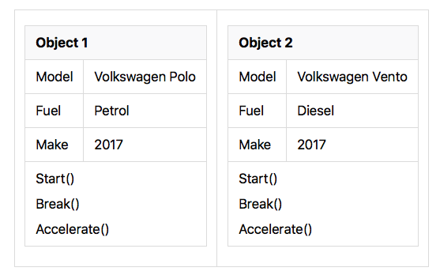
EXAMPLE INSTANCES

Slide 6
KEY CONCEPTS
Abstraction
What the object does instead of how it is done
Low-level details are hidden within class details
Encapsulation
Data and behaviour bound together in single unit

Slide 7
INHERITANCE
Derived classes “inherit” properties of base classes
Common properties can be shared within a “class” of classes

Slide 8
NEUROIMAGING CONTEXT
Brain Scan
MR Scan
PET Scan
T1
T2
Static
Func.
fMRI
DWI
Sub-classes of neuroimaging modalities/contrasts

Slide 9
POLYMORPHISM
Different classes of objects which do the same things (in a particular context)
Can be sub-classes of one another but not necessary

Slide 10
ARCANA + BANANA

Slide 11
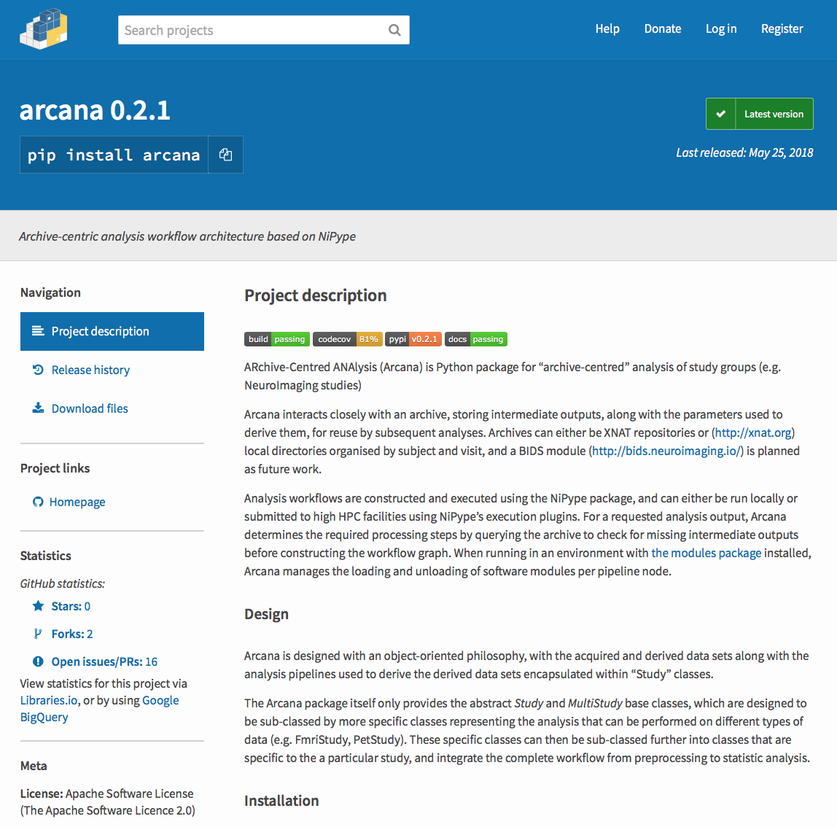
ARCANA: PYTHON FRAMEWORK
Portable “end-to-end” workflows
Data repository to publication results
Transparent repository access
XNAT (xnat.org)
BIDS (bids.neuroimaging.io)
Scalable
Local workstation
High Performance Computing (HPC)
Extensible
Collaborate on standard methods
Specialise to study-specific requirements
pypi.org/project/arcana/
arcana.readthedocs.io

Slide 12
STRUCTURE OF ARCANA
Analysis definitions in Study classes
Specific to a type of image (e.g. T1-weighted MRI, dMRI, etc…)
Free parameters
Extensible via class inheritance
Analysis application by Study objects
Parameterisations
Specify input data
Specify data storage and execution environment

Slide 13
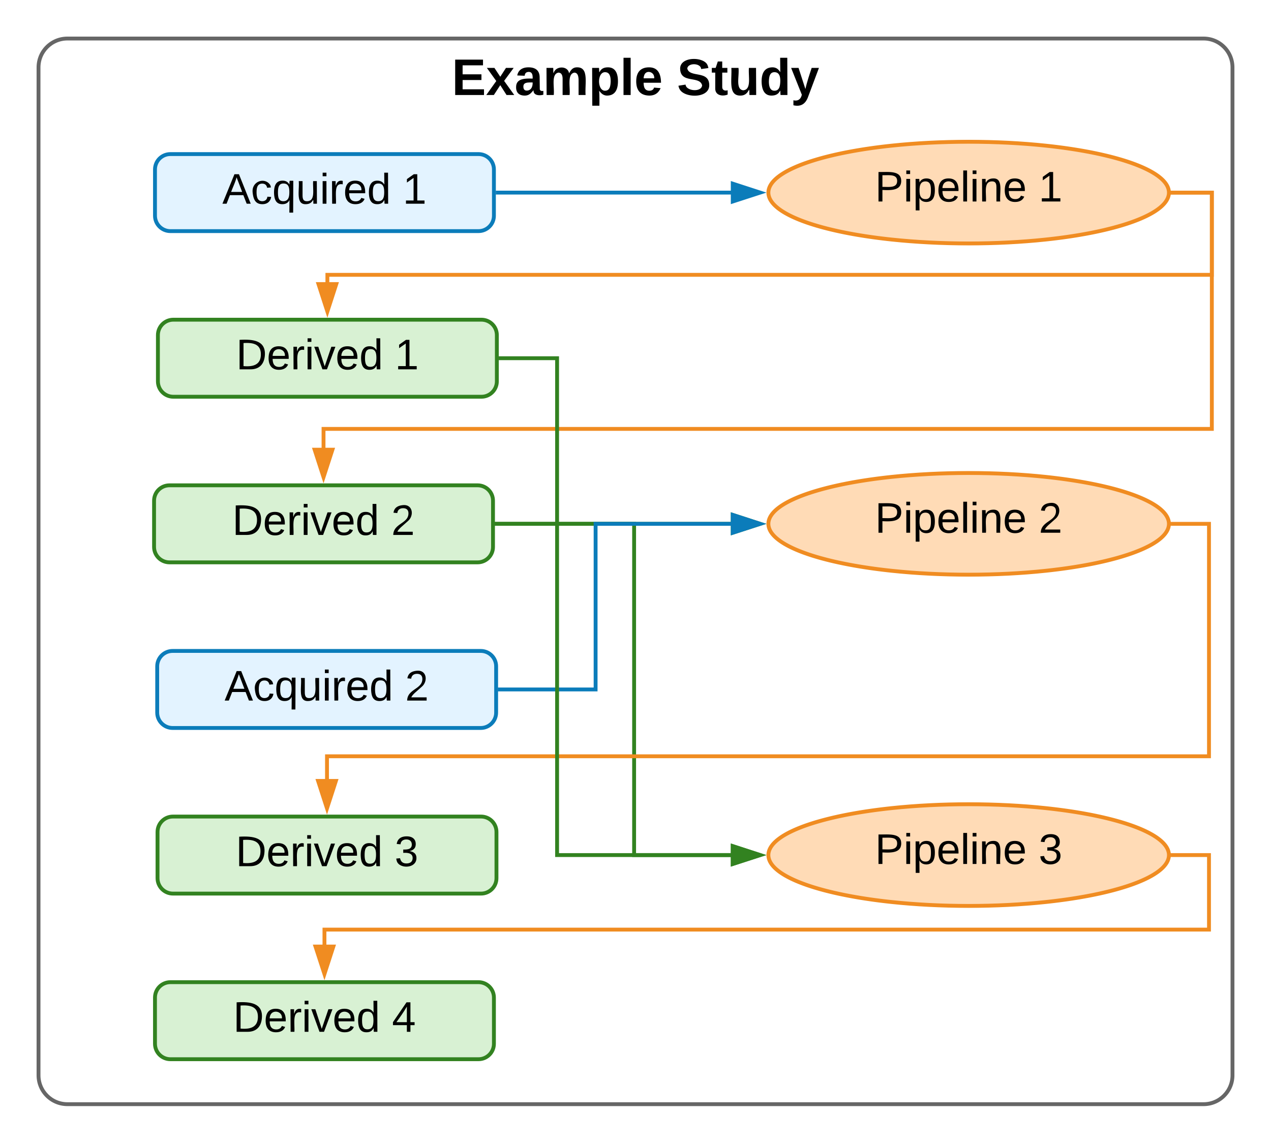
STUDY CLASS: ANALYSIS DESIGN
Acquired File-sets or fields
Pipelines
Derived
File-sets or fields
Data specification table
Pipeline constructor methods

Slide 14
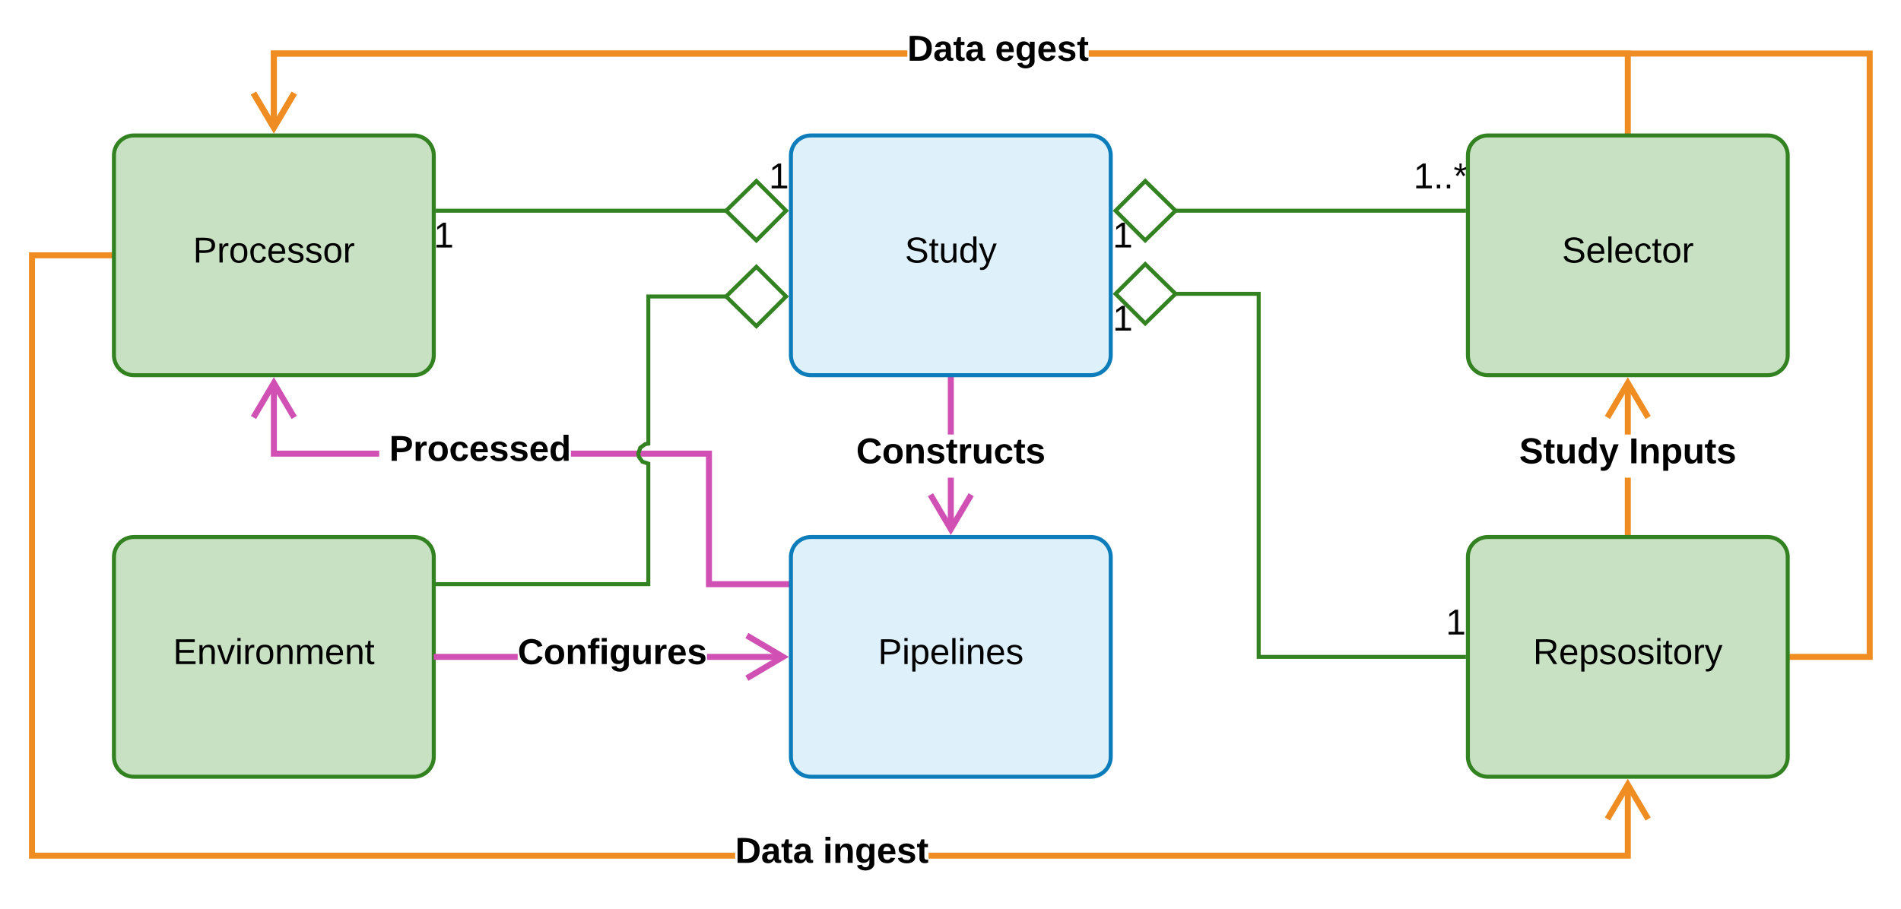
STUDY INSTANCE: APPLICATION TO DATA
Linear | multi-proc | SLURM | AWS
Input file-set | field
Static | “Modules” (HPC) | Docker
XNAT | BIDS | Plain-dir.
Notes:
Add reference to PyPI image

Slide 15
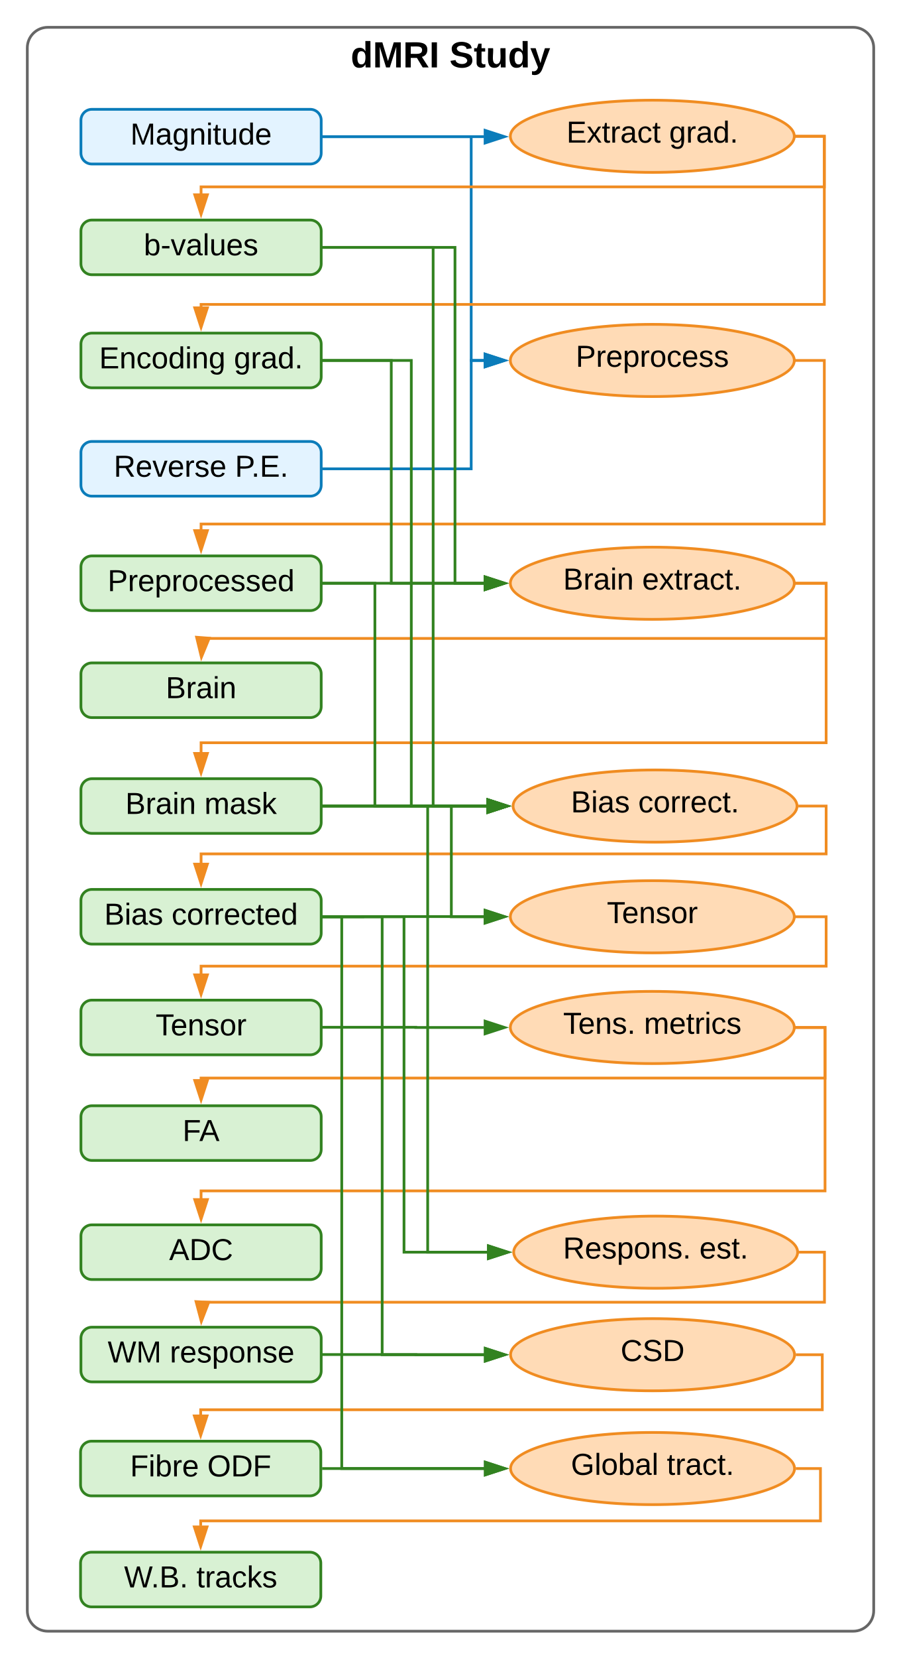
DIFFUSION MRI (DMRI) STUDY CLASS
Tensor metrics
FA, ADC
Tracks white matter tracts
long-range connections
Inherits common methods from base classes
MRI > EPI > dMRI > …
Registration, brain extraction
Reuses common derivatives
Preprocessing, Brain mask, etc..

Slide 16
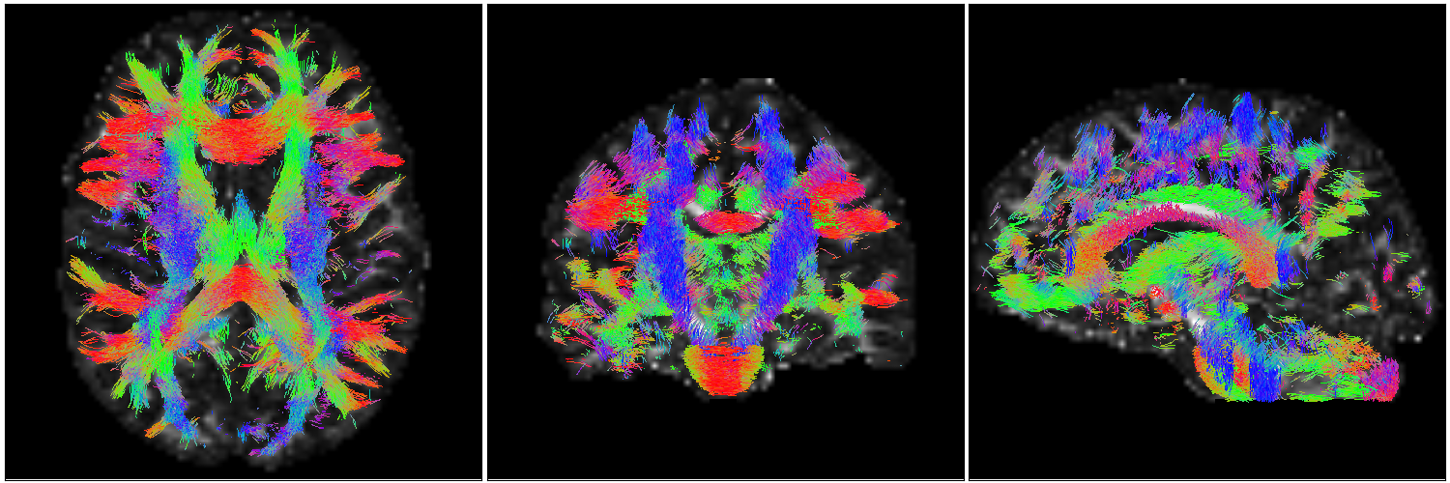
DMRI STUDY CLASS APPLICATION: GLOBAL TRACTOGRAPHY (STREAMLINES)
axial
coronal
sagittal
Red = left-to-right, Green= front-to-back, Blue = top-to-bottom

Slide 17
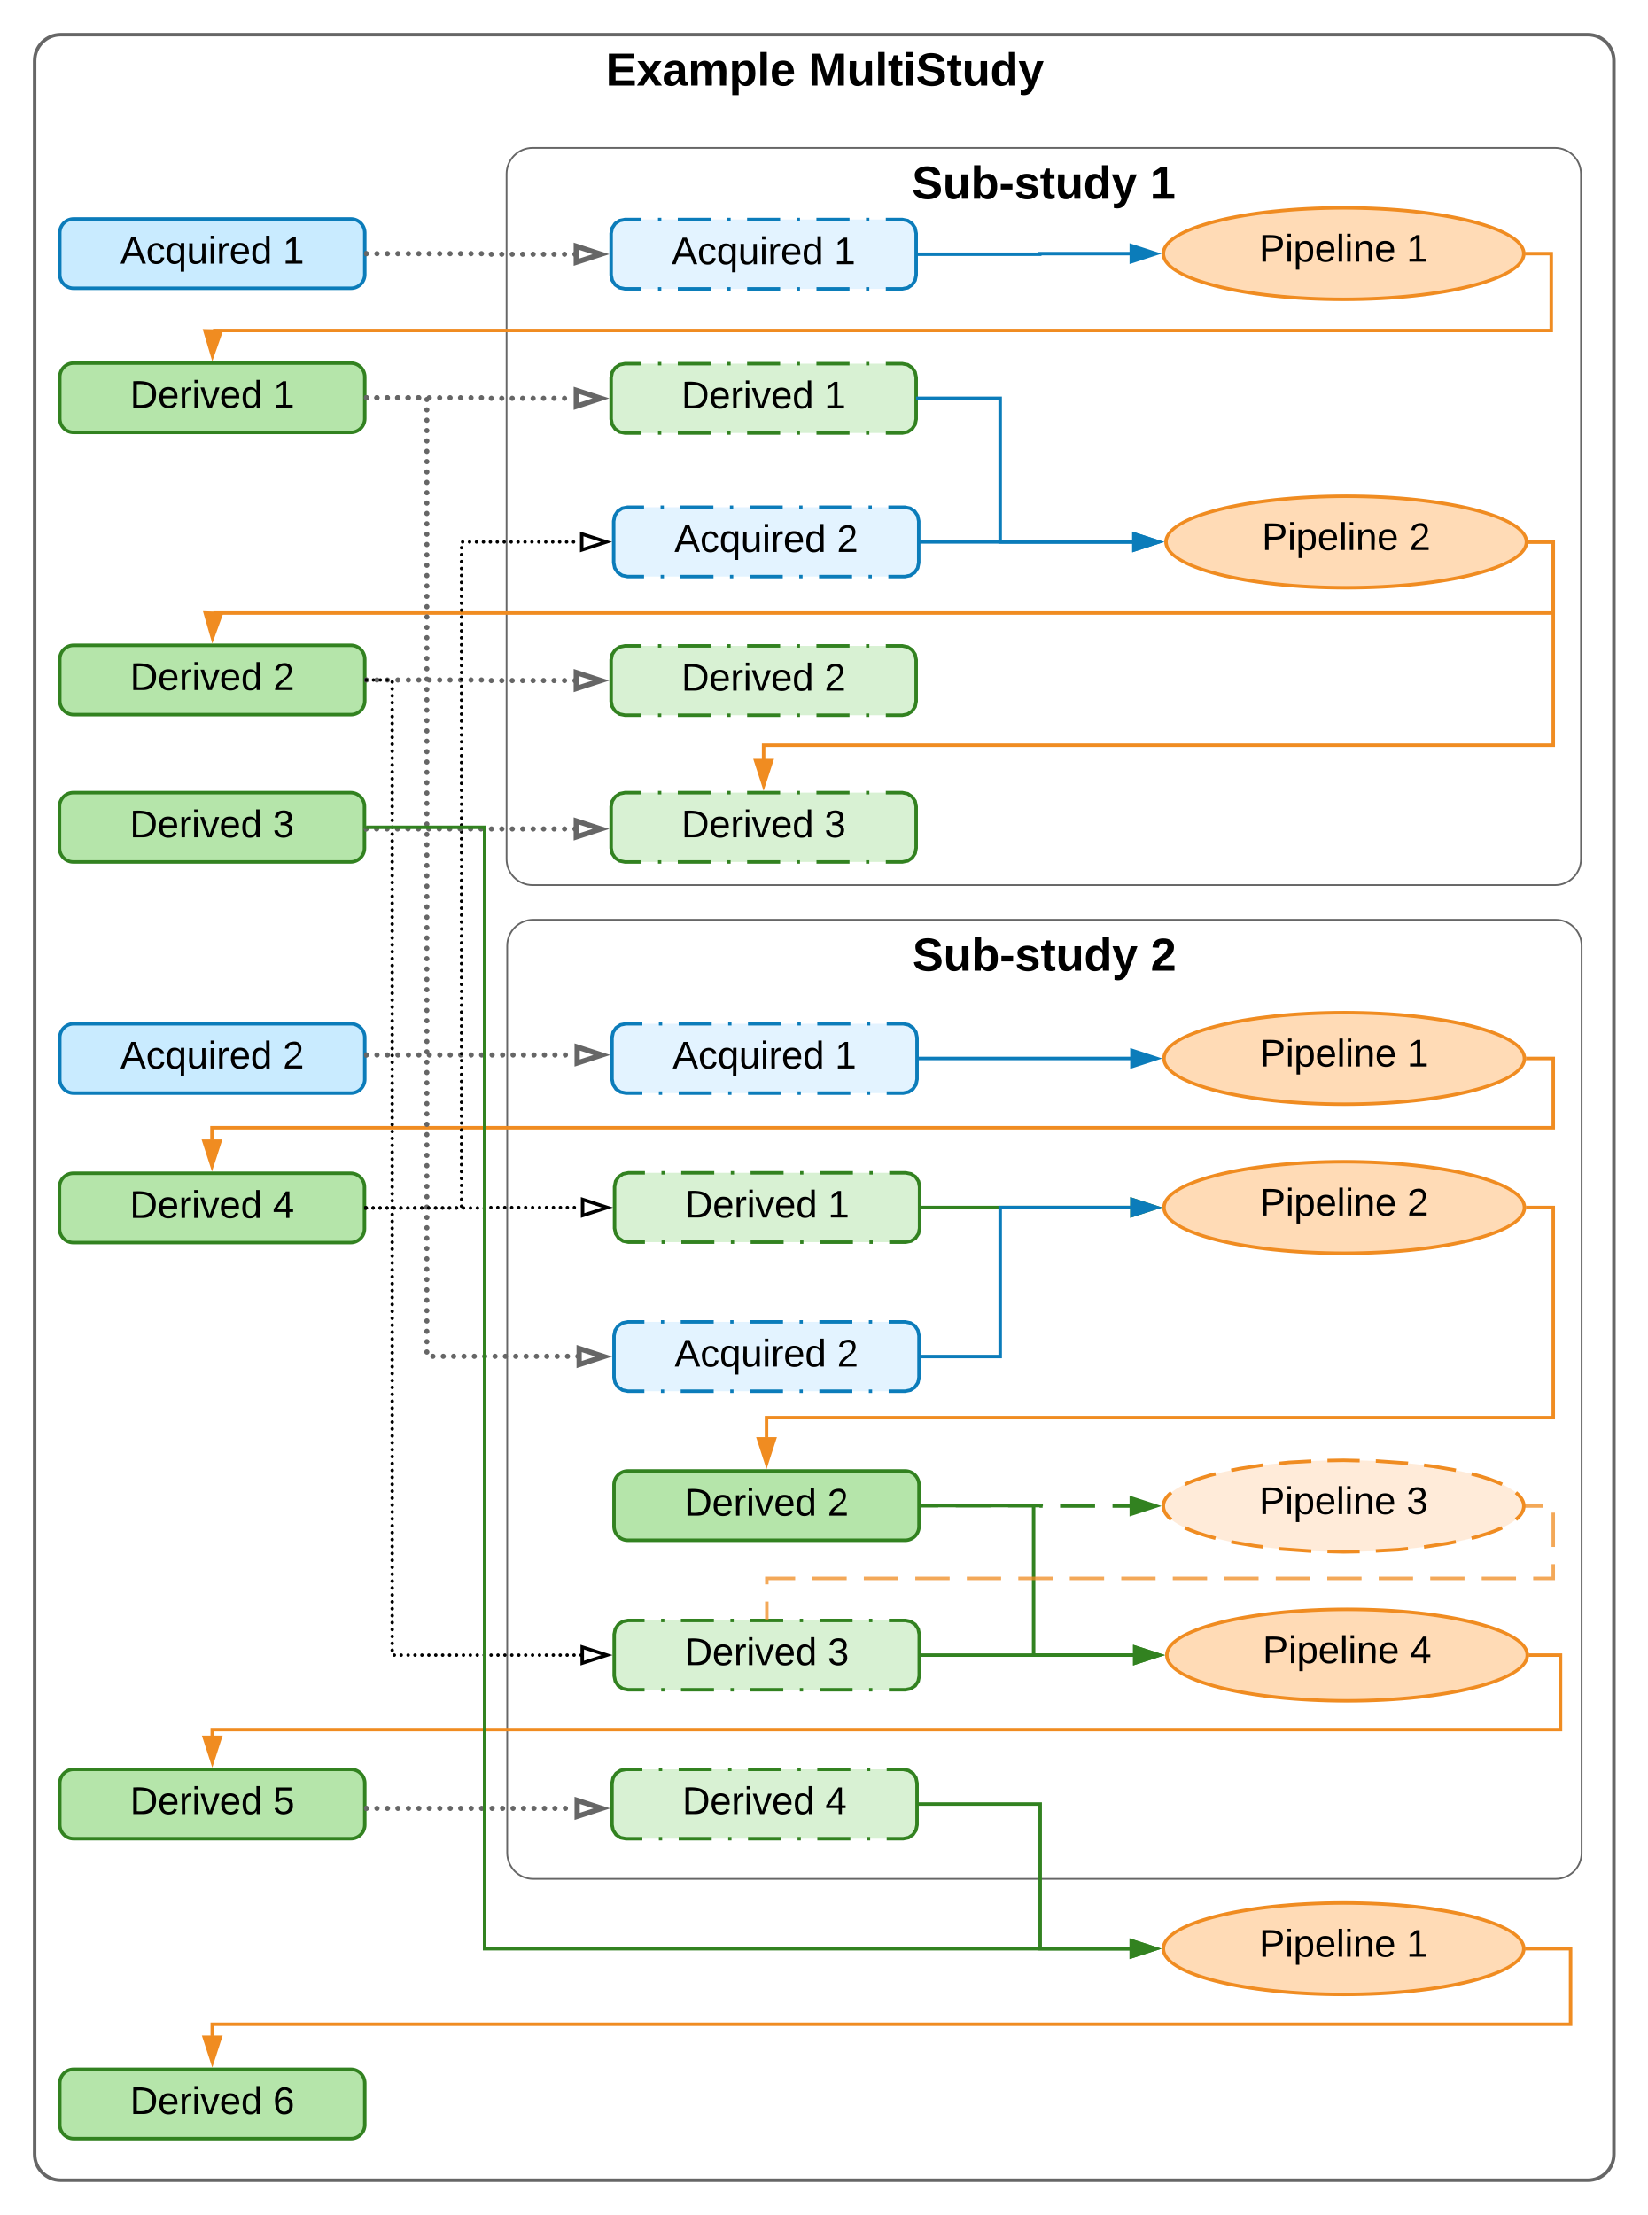
MULTI-STUDY: COMBINING STUDY CLASSES

Slide 18
MR-PET MOTION CORRECTION PIPELINE
Concurrent MR-PET acquisition
PET acquisition: ~ 1.5 hours
Each MR acquisition: 5-20 mins
Detect motion from MR images
Contrast-specific analyses
Arbitrary sequence of contrasts
* Motion manually introduced

Slide 19
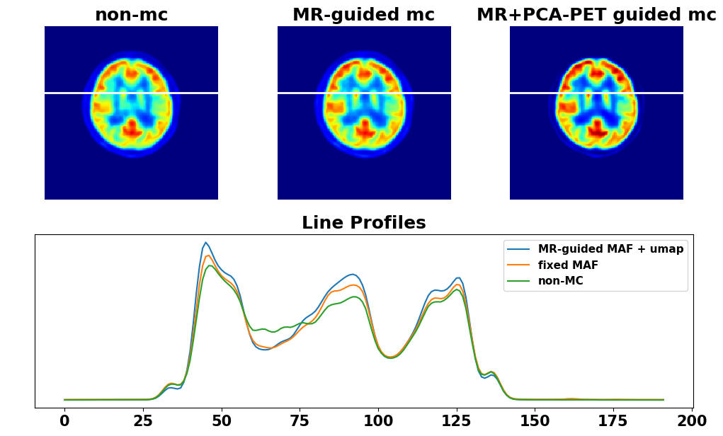
MR-PET MOTION CORRECTION PIPELINE RESULTS
Original
Motion corrected

Slide 20

BIOMEDICAL IMAGING ANALYSIS (BANANA)
Arcana Study classes for biomedical imaging
T1Study/T2Study
DmriStudy
T2starStudy
Available on GitHub and PyPI
github.com/MonashBI/banana
pypi.org/projects/banana
Collaborate with other groups
Package up into containers
BIDS apps
XNAT containers
a banana

